Slide 1

Kerberos
www. cuchd.in Campus : Gharaun, Mohali

Slide 2
Kerberos
•Kerberos: Network security protocol
•Part of project Athena (MIT).
•Uses trusted 3rd party authentication scheme.
•Assumes that hosts are not trustworthy.
Requires that each client (each request for service) prove it’s identity.
Does not require user to enter password every time a service is requested!
Uses Needham-Schroeder Algorithm.

Slide 3
History & Development
Steve Miller and Clifford Neuman designed the primary Kerberos version.
Versions 1–3 occurred only internally at MIT as part of project Athena.
Windows 2000 was Microsoft's first system to implement Kerberos security standard.
Version 5, designed by John Kohl and Clifford Neuman, appeared in 1993 .

Slide 4
History & Development
Recent updates includes:
Encryption and Checksum Specifications.
Clarification of the protocol with more detailed and clearer explanation of intended use.
A new edition of the GSS-API( Generic Security Service Application Program Interface ) specification.

Slide 5
Need
•Authentication-
divide up resources with capabilities between many users
restrict user’s access to resources.
typical authentication mechanism – passwords.
•But regular password authentication is useless in the face of a computer network (as in the Internet)
systems crackers (hacker) can easily intercept these passwords while on the wire.

Slide 6
Need
Firewalls make a risky assumption: that attackers are coming from the outside. In reality, attacks frequently come from within.
Assumes “bad guys” are on the outside….while the really damaging ones can be inside !!
Restrict use of Internet.
Kerberos assumes that network connections (rather than servers and work stations) are the weak link in network security.

Slide 7
NEEDHAM-SCHROEDER PROTOCOL
The Needham-Schroeder Symmetric Key establishes a session key to protect further communication.
The Needham-Schroeder Public-Key Protocol provides mutual authentication.

Slide 8
NEEDHAM-SCHROEDER PROTOCOL
Let Alice (A) initiates the communication to Bob (B).
 S is a server trusted by both parties
 K_{AS} is a symmetric key known only to A and S
 K_{BS} is a symmetric key known only to B and S
 N_{A} and N_{B} are nonces

Slide 9
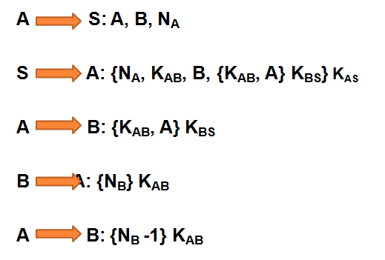
SYMMETRIC KEY PROTOCOL
.

Slide 10
PUBLIC KEY PROTOCOL
Alice (A) and Bob (B) use a trusted server (S) to distribute public keys on request. These keys are:
K_{PA} & K_{SA}, public and private halves of an encryption key-pair belonging to A.
K_{PB} & K_{SB}, similar belonging to B.
K_{PS} & K_{SS}, similar belonging to S.
Note : K_{SS} is used to encrypt while K_{PS} to decrypt.

Slide 11
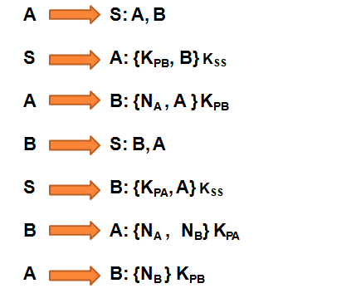
NEEDHAM-SCHROEDER PROTOCOL

Slide 12
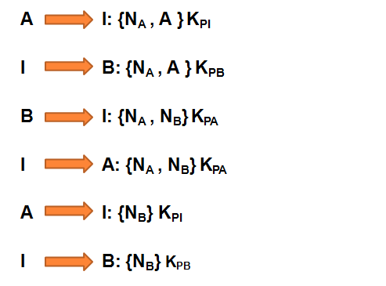
ATTACK ON NEEDHAM-SCHROEDER PROTOCOL

Slide 13
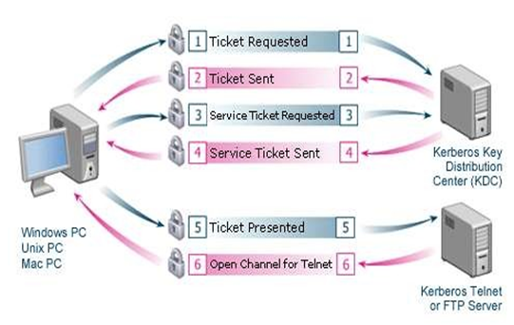
WORKING

Slide 14
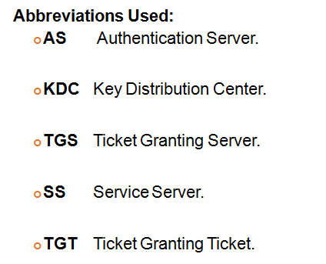
.

Slide 15
User Client-based Logon Steps:
A user enters a username and password on client
machine.
The client performs a one-way function on the entered password, and this becomes the secret key of the client/user.

Slide 16
Client Authentication Steps:
The client sends a message to AS requesting services on behalf of the user.
If client is in Database, AS sends back message which Client decrypts to obtain the Client/TGS Session Key for further communications with TGS.

Slide 17
Client Service Authorization Steps:
Client sends messages to TGS to get "client/TGS session key” using TGS secret key and sends following two messages to the client:
Client-to-server ticket encrypted using the service's secret key.
Client/server session key encrypted with the Client/TGS Session Key.

Slide 18
Client Service Request Steps:
The client now can authenticate itself to the SS.
The SS decrypts ticket to ultimately retrieve Authenticator and sends confirmation to client.
Client decrypts the confirmation using the Client/Server Session Key and connection is set up.

Slide 19
Services of Kerberos
¢Authentication
¢Authorization
¢Confidentiality
¢Within networks and small sets of networks

Slide 20
Weakness of Kerberos
Single point of failure.
Requires synchronization of involved host’s clocks.
The administration protocol is not standardized.
Compromise of central server will compromise all users' secret keys. If stolen, TGT can be used to access network services of others.

Slide 21
What is a Firewall?
A firewall can be defined as a special type of network security device or a software program that monitors and filters incoming and outgoing network traffic based on a defined set of security rules. It acts as a barrier between internal private networks and external sources (such as the public Internet).
The primary purpose of a firewall is to allow non-threatening traffic and prevent malicious or unwanted data traffic for protecting the computer from viruses and attacks. A firewall is a cybersecurity tool that filters network traffic and helps users block malicious software from accessing the Internet in infected computers.

Slide 22
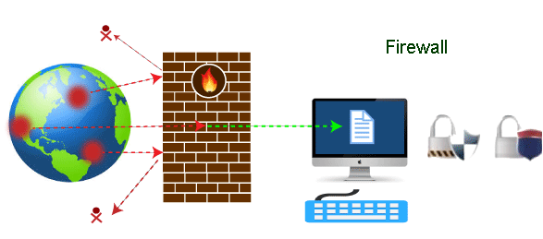

Slide 23
Firewall: Hardware or Software
A firewall can be a network security device or a software program on a computer. This means that the firewall comes at both levels, i.e., hardware and software, though it's best to have both.
Each format (a firewall implemented as hardware or software) has different functionality but the same purpose. A hardware firewall is a physical device that attaches between a computer network and a gateway. For example, a broadband router. On the other hand, a software firewall is a simple program installed on a computer that works through port numbers and other installed software.

Slide 24
Firewall Use
Firewalls are primarily used to prevent malware and network-based attacks. Additionally, they can help in blocking application-layer attacks. These firewalls act as a gatekeeper or a barrier. They monitor every attempt between our computer and another network. They do not allow data packets to be transferred through them unless the data is coming or going from a user-specified trusted source.
Firewalls are designed in such a way that they can react quickly to detect and counter-attacks throughout the network. They can work with rules configured to protect the network and perform quick assessments to find any suspicious activity. In short, we can point to the firewall as a traffic controller.

Slide 25
Risks of not having a firewall are:
Open Access : -If a computer is running without a firewall, it is giving open access to other networks. This means that it is accepting every kind of connection that comes through someone. In this case, it is not possible to detect threats or attacks coming through our network. Without a firewall, we make our devices vulnerable to malicious users and other unwanted sources.
Lost or Comprised Data:-Without a firewall, we are leaving our devices accessible to everyone. This means that anyone can access our device and have complete control over it, including the network. In this case, cybercriminals can easily delete our data or use our personal information for their benefit.

Slide 26
Network Crashes:- In the absence of a firewall, anyone could access our network and shut it down. It may lead us to invest our valuable time and money to get our network working again.
Therefore, it is essential to use firewalls and keep our network, computer, and data safe and secure from unwanted sources

Slide 27
Firewall work
A firewall system analyzes network traffic based on pre-defined rules. It then filters the traffic and prevents any such traffic coming from unreliable or suspicious sources. It only allows incoming traffic that is configured to accept.
Typically, firewalls intercept network traffic at a computer's entry point, known as a port. Firewalls perform this task by allowing or blocking specific data packets (units of communication transferred over a digital network) based on pre-defined security rules. Incoming traffic is allowed only through trusted IP addresses, or sources.

Slide 28
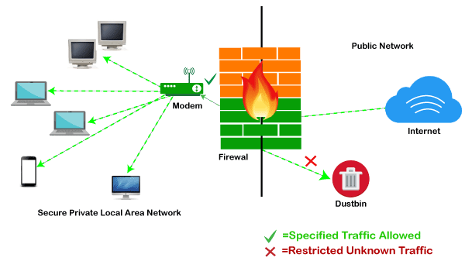

Slide 29
Functions of Firewall
Network Threat Prevention
Application and Identity-Based Control
Hybrid Cloud Support
Scalable Performance
Network Traffic Management and Control
Access Validation
Record and Report on Events

Slide 30
Limitations of Firewall
Firewalls cannot stop users from accessing malicious websites, making it vulnerable to internal threats or attacks.
Firewalls cannot protect against the transfer of virus-infected files or software.
Firewalls cannot prevent misuse of passwords.
Firewalls cannot protect if security rules are misconfigured.
Firewalls cannot protect against non-technical security risks, such as social engineering.
Firewalls cannot stop or prevent attackers with modems from dialing in to or out of the internal network.
Firewalls cannot secure the system which is already infected.

Slide 31
Types of Firewall
Proxy Firewall (Application-level Gateways):-operate at the application layer as an intermediate device to filter incoming traffic between two end systems.
Packet-filtering firewalls:-the most basic type of firewall. It acts like a management program that monitors network traffic and filters incoming packets based on configured security rules
Stateful Multi-layer Inspection (SMLI) Firewall:-include both packet inspection technology and TCP handshake verification
Unified threat management (UTM) firewall:-includes features of a stateful inspection firewall with anti-virus and intrusion prevention support.
Next-generation firewall (NGFW):-include deep-packet inspection (DPI), surface-level packet inspection, and TCP handshake testing
Network address translation (NAT) firewalls:-primarily designed to access Internet traffic and block all unwanted connections. These types of firewalls usually hide the IP addresses of our devices, making it safe from attackers.

Slide 32
Difference between a Firewall and Anti-virus
 | Firewall | Anti-virus
 | A firewall is defined as the system which analyzes and filters incoming or outgoing data packets based on pre-defined rules. | Anti-virus is defined as the special type of software that acts as a cyber-security mechanism. The primary function of Anti-virus is to monitor, detect, and remove any apprehensive or distrustful file or software from the device.
 | Firewalls can be hardware and software both. The router is an example of a physical firewall, and a simple firewall program on the system is an example of a software firewall. | Anti-virus can only be used as software. Anti-virus is a program that is installed on the device, just like the other programs.
 | Because firewalls come in the form of hardware and software, a firewall can be implemented either way. | Because Anti-virus comes in the form of software, therefore, Anti-virus can be implemented only at the software level. There is no possibility of implementing Anti-virus at the hardware level.
 | A firewall is usually defined as a network controlling system. It means that firewalls are primarily responsible for monitoring and filtering network traffic. | Anti-viruses are primarily responsible for detecting and removing viruses from computer systems or other devices. These viruses can be in the form of infected files or software.
 | Because the firewall supports both types of implementations, hardware, and software, therefore, it is more scalable than anti-virus. | Anti-viruses are generally considered less-scalable than firewalls. This is because anti-virus can only be implemented at the software level. They don't support hardware-level implementation.
 | A firewall is mainly used to prevent network related attacks. It mainly includes external network threats?for example- Routing attacks and IP Spoofing. | Anti-virus is mainly used to scan, find, and remove viruses, malware, and Trojans, which can harm system files and software and share personal information (such as login credentials, credit card details, etc.) with hackers.

Slide 33
Importance of Cyber Security
Protecting Identity: Cyber security ensures that individuals’ identity is protected and authenticity is maintained while using technology.
Maintaining Privacy: Cyber security caters to the requirement of information or content that is confidential is extremely secure. Users can trust the technology for use.
Securing Confidential Content: Sensitive information is the most vulnerable to security threats. Attack on sensitive information such as bank information is most common and done for monetary frauds.

Slide 34
Intruder
The most common threat to security is the attack by the intruder. Intruders are often referred to as hackers and are the most harmful factors contributing to the vulnerability of security. They have immense knowledge and an in-depth understanding of technology and security.
Aim :- stealing the confidential information of the users.
The stolen information is then sold to third-party, which aim at misusing the information for their own personal or professional gains.

Slide 35
Intruders are divided into three categories
Masquerader: The category of individuals that are not authorized to use the system but still exploit user’s privacy and confidential information by possessing techniques that give them control over the system, such category of intruders is referred to as Masquerader. Masqueraders are outsiders and hence they don’t have direct access to the system, their aim is to attack unethically to steal data/ information.
Misfeasor: The category of individuals that are authorized to use the system, but misuse the granted access and privilege. These are individuals that take undue advantage of the permissions and access given to them, such category of intruders is referred to as Misfeasor. Misfeasors are insiders and they have direct access to the system, which they aim to attack unethically for stealing data/ information.
Clandestine User: The category of individuals those have supervision/administrative control over the system and misuse the authoritative power given to them. The misconduct of power is often done by superlative authorities for financial gains, such a category of intruders is referred to as Clandestine User. A Clandestine User can be any of the two, insiders or outsiders, and accordingly, they can have direct/ indirect access to the system, which they aim to attack unethically by stealing data/ information.

Slide 36
Intrusion detection system
A system called an intrusion detection system (IDS) observes network traffic for malicious transactions and sends immediate alerts when it is observed. It is software that checks a network or system for malicious activities or policy violations. Each illegal activity or violation is often recorded either centrally using a SIEM system or notified to an administration. IDS monitors a network or system for malicious activity and protects a computer network from unauthorized access from users, including perhaps insiders. The intrusion detector learning task is to build a predictive model (i.e. a classifier) capable of distinguishing between ‘bad connections’ (intrusion/attacks) and ‘good (normal) connections’.

Slide 37
Work
An IDS (Intrusion Detection System) monitors the traffic on a computer network to detect any suspicious activity.
It analyzes the data flowing through the network to look for patterns and signs of abnormal behavior.
The IDS compares the network activity to a set of predefined rules and patterns to identify any activity that might indicate an attack or intrusion.
If the IDS detects something that matches one of these rules or patterns, it sends an alert to the system administrator.
The system administrator can then investigate the alert and take action to prevent any damage or further intrusion.

Slide 38
References
https://www.simplilearn.com/what-is-kerberos-article
https://www.geeksforgeeks.org/kerberos/
https://docs.axway.com/bundle/APIGateway_762_IntegrationKerberos_allOS_en_HTML5/page/Content/KerberosIntegration/kerberos_overview.html

Slide 39
E- Books Recommended
https://www.jigsawacademy.com/blogs/cyber-security/kerberos-authentication/
https://www.worldcat.org/title/kerberos-the-definitive-guide/oclc/780425105

